Slide 1
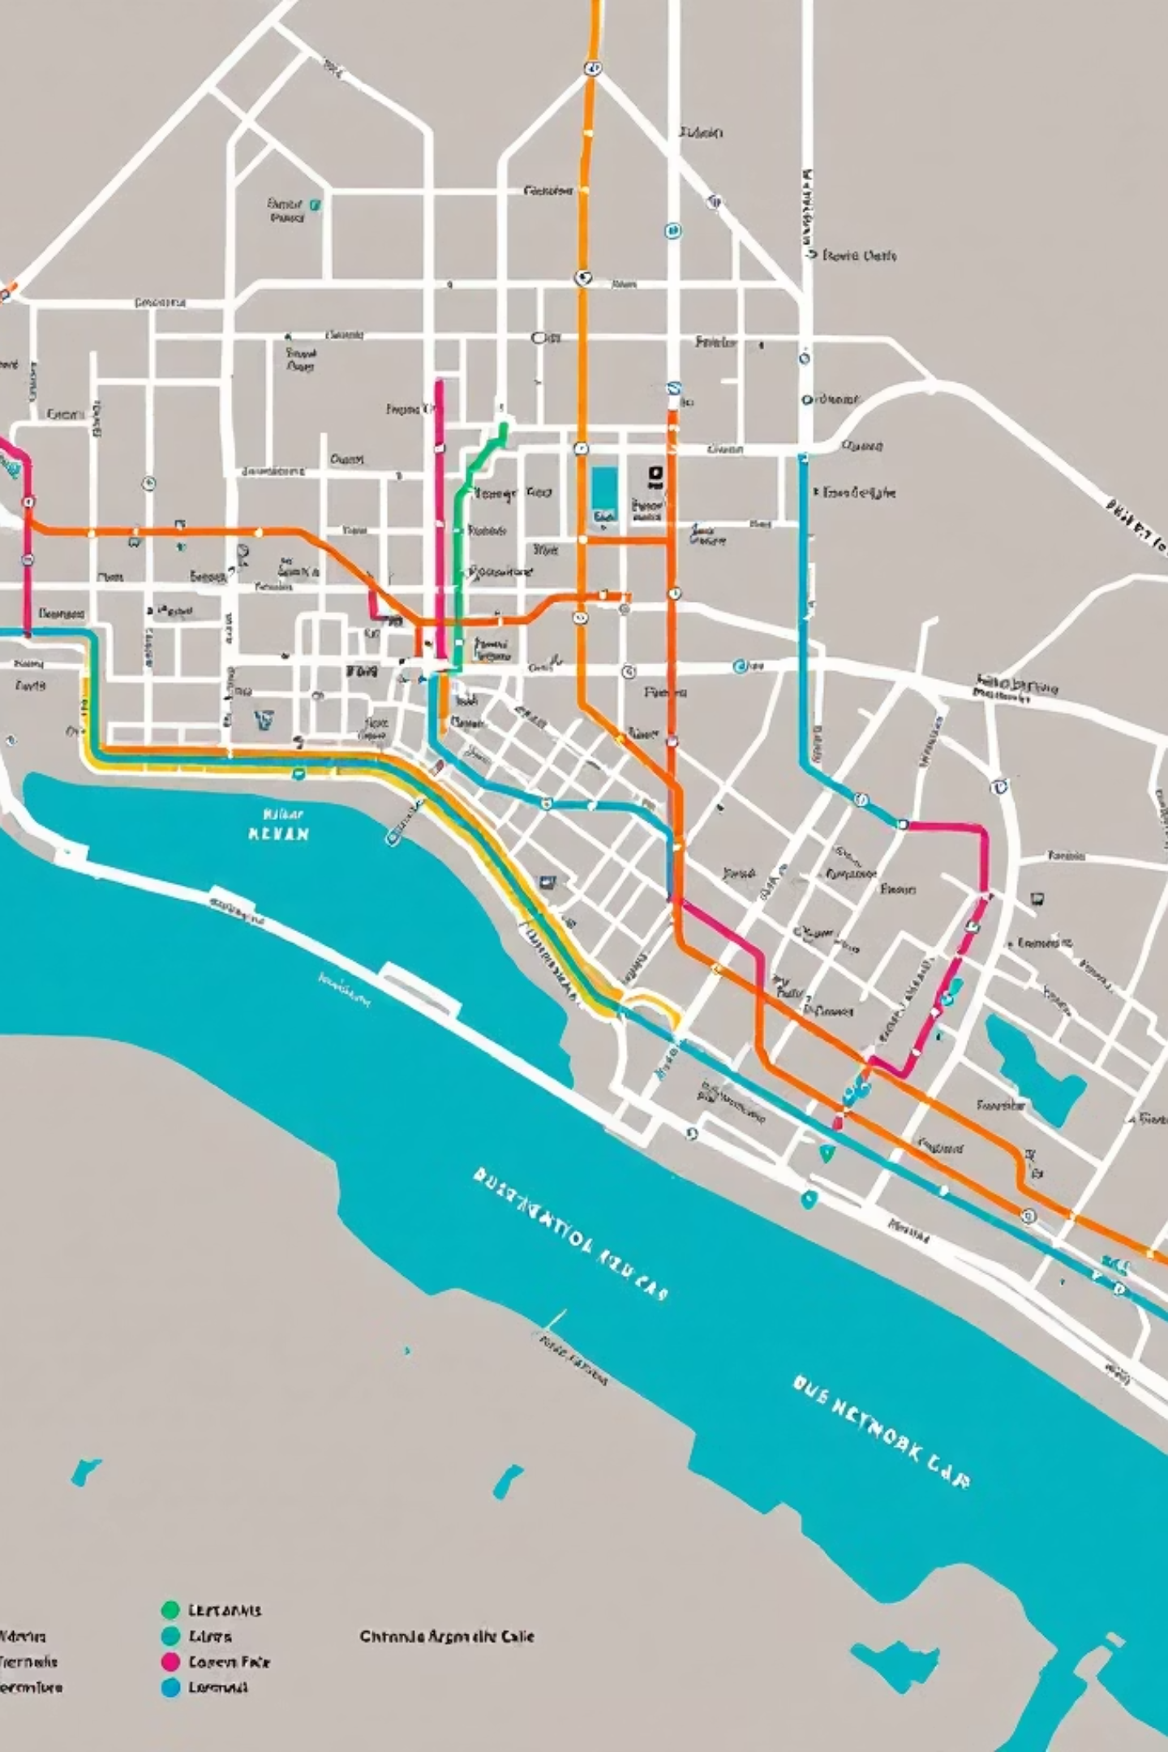
Dream Transport:
From Complex Data to Clear Decisions
Efficient Fahrplan Optimization for Smart Mobility
A collaborative project for transforming complex transportation data into actionable insights

Slide 2

The Challenge (Before)
Overwhelming data, difficult insights.
Raw Data Overload
Complex Analysis Required
14+ separate files with different formats (PDF, Excel, CSV)
Transportation schedules, passenger counts, and punctuality metrics scattered across documents

Slide 3

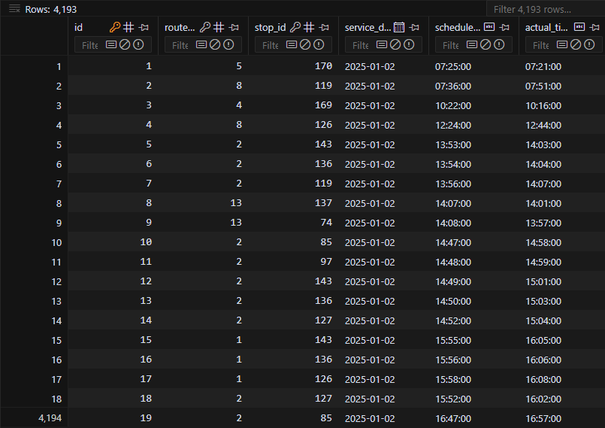
Our Solution (After)
From Chaos to Clarity
We transformed scattered transportation data into a unified, optimized system:
Consolidated SQLite database
Data-powered optimization
Clear visualization of results

Slide 4



Project Components
Data Integration
Analysis Tools
Output Generation
SQLite database with schema.sql for unified data storage
Python scripts for distance computation and hub optimization
CSV and JSON outputs for selected hubs and optimized routes
Key files: build_db.py, compute_stop_distances.py, hub_optimizer.py, and select_hubs.py

Slide 5






Technical Implementation
DreamTransport employs a sophisticated blend of backend technologies, advanced optimization algorithms, and a structured data model to deliver efficient public transport solutions.
Backend & Data Processing
Optimization Algorithms
Structured Data Model
Built with Python 3.x, utilizing SQLite for data storage and Pandas for powerful data analysis. PDFplumber handles data extraction from diverse formats.
Incorporates K-Median for hub placement, Hub-and-Spoke for route optimization, and Greedy/Batch methods for continuous improvement. Haversine distance ensures accurate geographical calculations.
Organizes crucial transport information in dedicated tables: stops (with coordinates), routes, route_stops, and performance_metrics (for punctuality).
The system optimizes based on passenger-weighted distances, average hops, hub load distribution, and route complexity, providing detailed outputs for informed decision-making.

Slide 6
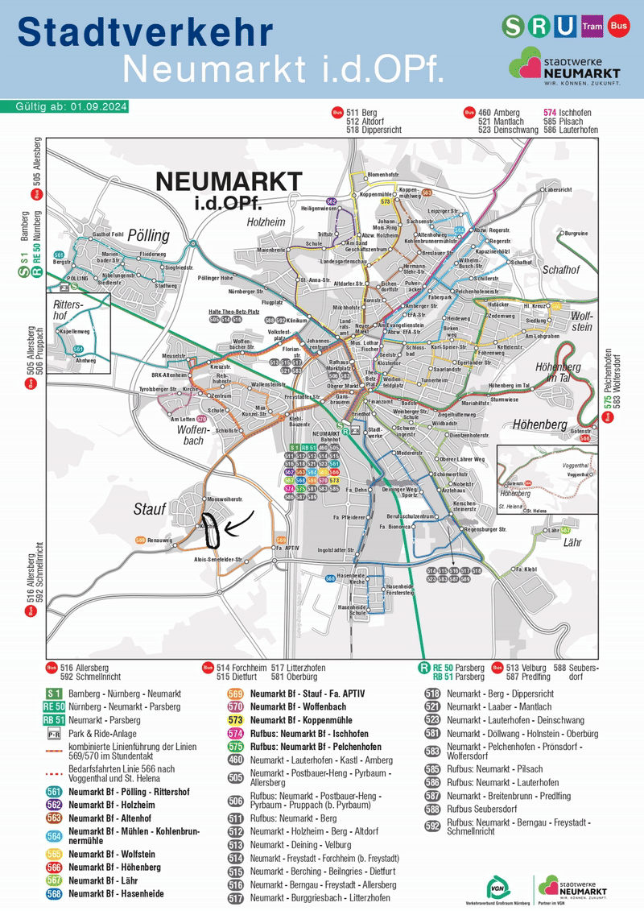
Technical Implementation
Key Algorithms
Stop distance computation
Hub selection optimization
Route efficiency analysis
Outputs stored in hub_optimizer_outputs directory

Slide 7
Next Steps
From Data to Action
01
02
03
Expand Documentation
Implement Visualization
Gather Feedback
Add comprehensive project description and usage instructions
Create interactive maps and dashboards for route optimization
Test with transportation planners and refine based on real-world application
Join our project: Fork, star, or contribute to help transform public transportation planning

Slide 8
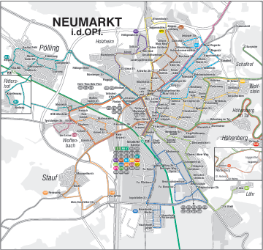
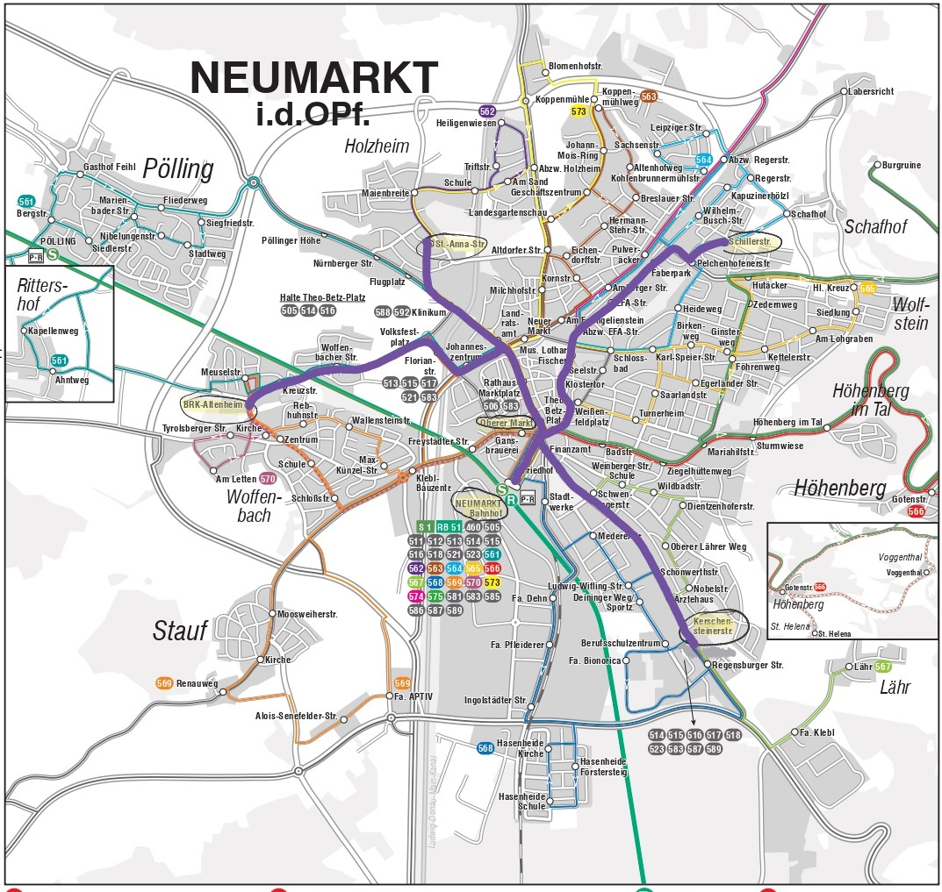
Optimized Network: Before & After
Witness the transformation of the bus network, from a complex web of routes to a streamlined, efficient system:
Before Optimization
After Optimization

